Slide 1

The Presentation Final
Mentor: Vo Tien Dung
Intern : Do Xuan Tien

Slide 2
INFORMATION
Mentor: Vo Tien Dung, Long Nguyen
Intern : Do Xuan Tien
Project: Websites that sell watches
Target : Develop yourself, improve techniques, Learn how to communicate with people

Slide 3
Contents of Presentation
1. Introduct ReactJS
2. Introduct Java
3. Spring Boot Framework
4. Introduction project
5. Demo Project
6. Lesson Learned

Slide 4
1. ReactJS

Slide 5

What is ReactJS ?
ReactJS is a JavaScript library not a FrameWork
ReactJS design according to the MVC model
React is the most popular JavaScript library for building user interfaces.

Slide 6
Why use ReactJS ?
03
01
02
04
Simple
Speed
Compared to other popular frontend frameworks like Angular & Vue, React is much easier to learn
React allows to use individual parts of the application on both the client side and the server side
Customize components
Efficiency
React comes with JSX, an optional syntax extension that allows you to write your own components.
React JS is designed to provide high performance. Provides virtual DOM programming and server-side rendering

Slide 7
2. JAVA

Slide 8
What is Java ?
Modern, advanced programming language
Java is a platform
Object-Oriented Programming Language.

Slide 9
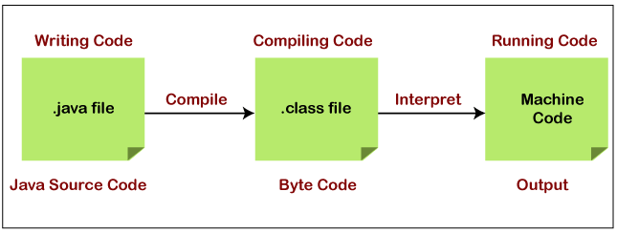
Interpreter

Slide 10
3. Spring boot

Slide 11
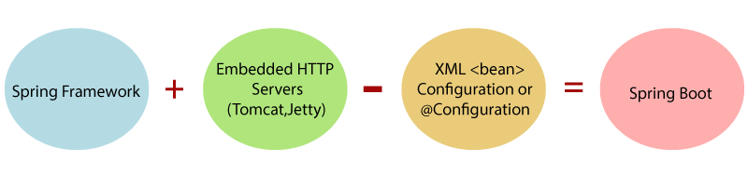
What is Spring Boot ?
Spring Boot is a module of the Spring Framework
It is a standard for software design configuration
Spring Boot does not require XML configuration

Slide 12
Advantage SpringBoot
Embed server to server apps directly
Create an independent app
Little configuration
Multiple supporting documents

Slide 13
4. Project
Website Selling Watches

Slide 14






Technology

Slide 15
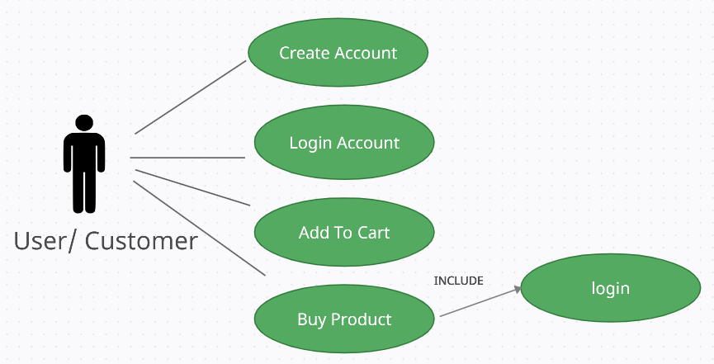
Use Case Diagram User

Slide 16
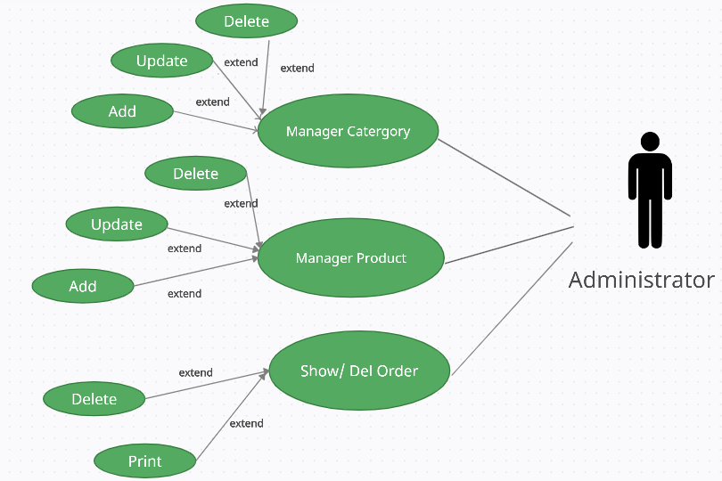
Use Case Diagram Admin

Slide 17
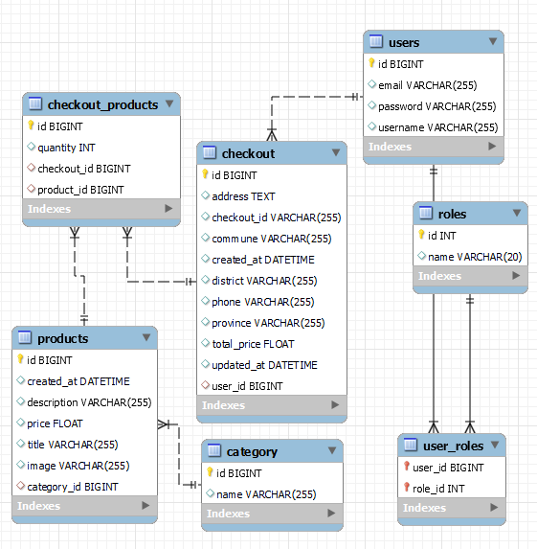
Database Diagram

Slide 18
5. Demo Project

Slide 19
Lesson learned
Use Git, Balsamiq Mockups, Trello, PostMan
Method Agile, learn work Etiquette & Professional Communication
Learn work in groups, Security Awreness, English
Use ReactJS, JS, SpringBoot

Slide 20
Thanks for watching!
Do you have any questions?
Email : doxuantien26200@gmail.com

